Slide 1
ST. Vincent Pallotti College of Engineering and Technology
DEPARTMENT OF INFORMATION TECHNOLOGY
Academic Year 2019-20
A Seminar on
Topic: Creation of Spellchecker for image processing on Tesseract-OCR and Google doc
Project by:
Parineeta Warade
Shruti Bangre
Rahul Raipurkar
Industry Guide: Dr. Soma Paul
Name of Industry: IIIT , Hyderabad
Name of College Guide: Prof. Vikas Bhowate

Slide 2
What is spellchecker?
A spell checker is an application, program or a function of a program which determines the correctness of the spelling of a given word based on the language set being used. It can either be a standalone program or part of a larger program which operates on blocks of text such as a word processor, search engine or an email client.

Slide 3
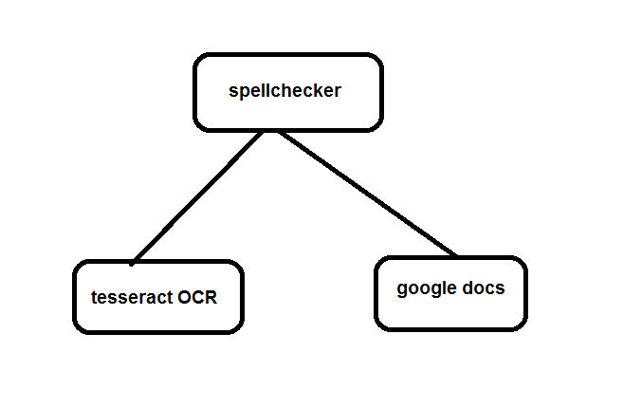

Slide 4
An optical character recognition (OCR) engine
Tesseract is an OCR engine with support for unicode and the ability to recognize more than 100 languages out of the box. It can be trained to recognize other languages.
Tesseract is an optical character recognition engine for various operating systems. It is free software, released under the Apache License, Version 2.0,and development has been sponsored by Google since 2006.
In 2006, Tesseract was considered one of the most accurate open-source OCR engines then available.
Tesseract up to and including version 2 could only accept TIFF images of simple one-column text as inputs. These early versions did not include layout analysis, and so inputting multi-columned text, images, or equations produced garbled output. Since version 3.00 Tesseract has supported output text formatting, hOCR positional information and page-layout analysis. Support for a number of new image formats was added using the Leptonica library. Tesseract can detect whether text is monospaced or proportionally spaced.

Slide 5
2. For best results, the image or PDF files need to meet certain requirements:
Resolution: High-resolution files work best. Google recommends each line of text in the documents to be of at least 10 pixels height.
Orientation: Only documents with horizontal left-to-right text are recognized. If you’ve scanned or captured a document in a different orientation, you can use a program like “Windows Photo Viewer” (part of Windows!) to retouch and edit images to rotate them before uploading to Google Drive.
File size limitations: The maximum size for images (.jpg, .gif, .png) and PDF files (.pdf) is 2 MB. For PDF files, Google looks only at the first 10 pages when searching for text to extract.

Slide 6
An optical character recognition (OCR) engine
Tesseract is an OCR engine with support for unicode and the ability to recognize more than 100 languages out of the box. It can be trained to recognize other languages.
Tesseract is an optical character recognition engine for various operating systems . It is free software, released under the Apache License, Version 2.0,and development has been sponsored by Google since 2006.
In 2006, Tesseract was considered one of the most accurate open-source OCR engines then available.
Tesseract up to and including version 2 could only accept TIFF images of simple one-column text as inputs. These early versions did not include layout analysis, and so inputting multi-columned text, images, or equations produced garbled output. Since version 3.00 Tesseract has supported output text formatting, hOCR positional information and page-layout analysis. Support for a number of new image formats was added using the Leptonica library. Tesseract can detect whether text is monospaced or proportionally spaced.

Slide 7
The initial versions of Tesseract could only recognize English-language text. Tesseract v2 added six additional Western languages (French, Italian, German, Spanish, Brazilian Portuguese, Dutch). Version 3 extended language support significantly to include ideographic (Chinese & Japanese) and right-to-left (e.g. Arabic, Hebrew) languages, as well as many more scripts. New languages included Arabic, Bulgarian, Catalan, Chinese (Simplified and Traditional), Croatian, Czech, Danish, German (Fraktur script), Greek, Finnish, Hebrew, Hindi, Hungarian, Indonesian, Japanese, Korean, Latvian, Lithuanian, Norwegian, Polish, Portuguese, Romanian, Russian, Serbian, Slovak (standard and Fraktur script), Slovenian, Swedish, Tagalog, Tamil, Thai, Turkish, Ukrainian and Vietnamese. V3.04, released in July 2015, added an additional 39 language/script combinations, bringing the total count of support languages to over 100. New language codes included: amh (Amharic), asm (Assamese), aze_cyrl (Azerbaijana in Cyrillic script), bod (Tibetan), bos (Bosnian), ceb (Cebuano), cym (Welsh), dzo (Dzongkha), fas (Persian), gle (Irish), guj (Gujarati), hat (Haitian and Haitian Creole), iku (Inuktitut), jav (Javanese), kat (Georgian), kat_old (Old Georgian), kaz (Kazakh), khm (Central Khmer), kir (Kyrgyz), kur (Kurdish), lao (Lao), lat (Latin), mar (Marathi), mya (Burmese), nep (Nepali), ori (Oriya), pan (Punjabi), pus (Pashto), san (Sanskrit), sin (Sinhala), srp_latn (Serbian in Latin script), syr (Syriac), tgk (Tajik), tir (Tigrinya), uig (Uyghur), urd (Urdu), uzb (Uzbek), uzb_cyrl (Uzbek in Cyrillic script), yid (Yiddish).
Tesseract can be trained to work in other languages too.
User interfaces
Tesseract is executed from the command-line interface . While Tesseract is not supplied with a GUI, there are many separate projects which provide a GUI for it. One common example is OCR Feeder.

Slide 8
Goggle docs
Advantages:
Collaboration - Work with others concurrently. Changes made go live instantly. No more wondering who has the latest version of the file.
Control - The document owner retains control of the file.
Secure - Since files are stored in the cloud, access via PC, Chromebook or Android. In the event of device loss, access using another device.
Restore - Restore to an earlier version if desired. Great for recovering from mistakes.
Table of Contents - Probably one of the easiest to use. Great for navigating within large files.
Unlimited storage

Slide 9
Disadvantages of google docs
It is cloud computing & there is no physical location of the documents shared.
Internet connection - Required for access to the full features of Google Docs.

Slide 10
Benefits or advantages of OCR
Following are the benefits or advantages of OCR: ➨In spite of rough handling, one can read the OCR information with high degree of accuracy. Flatbed scanners are very accurate and can produce reasonably high quality images. ➨The processing of OCR information is fast. Large quantities of text can be input quickly. ➨A paper based form can be turned into an electronic form which is easy to store or send by mail. ➨It is cheaper than paying someone amount to manually enter large amount of text data. Moreover it takes less time to convert in the electronic form. ➨The latest software can re-create tables as well as original layout.

Slide 11
Drawbacks or disadvantages of OCR
Following are the drawbacks or disadvantages of OCR: ➨OCR text works well with printed text only and not with handwritten text. Handwriting needs to be learnt by the computer. ➨OCR systems are expensive. ➨Images produced by scanner consume lot of memory space. ➨Images lose some quality during scanning and digitizing process. ➨Quality of the final image depends on quality of the original image. ➨All the documents need to be checked over carefully and then manually corrected.

Slide 12
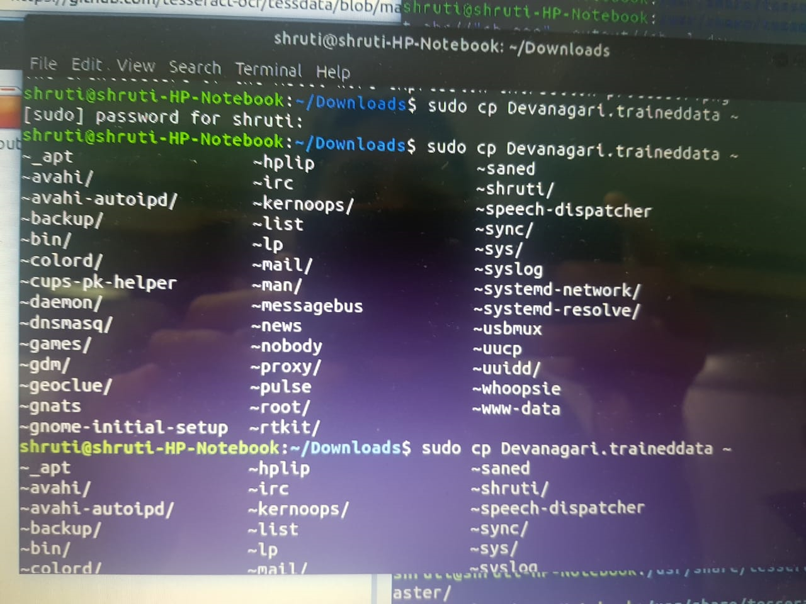

Slide 13
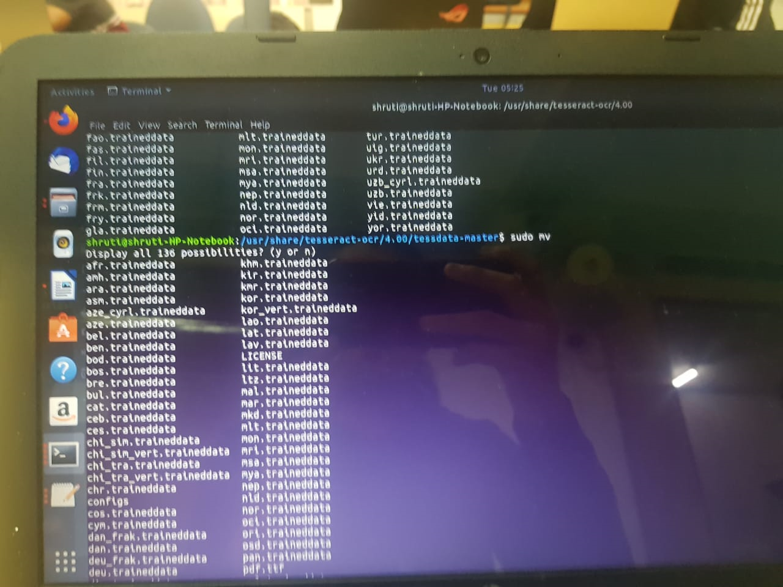

Slide 14
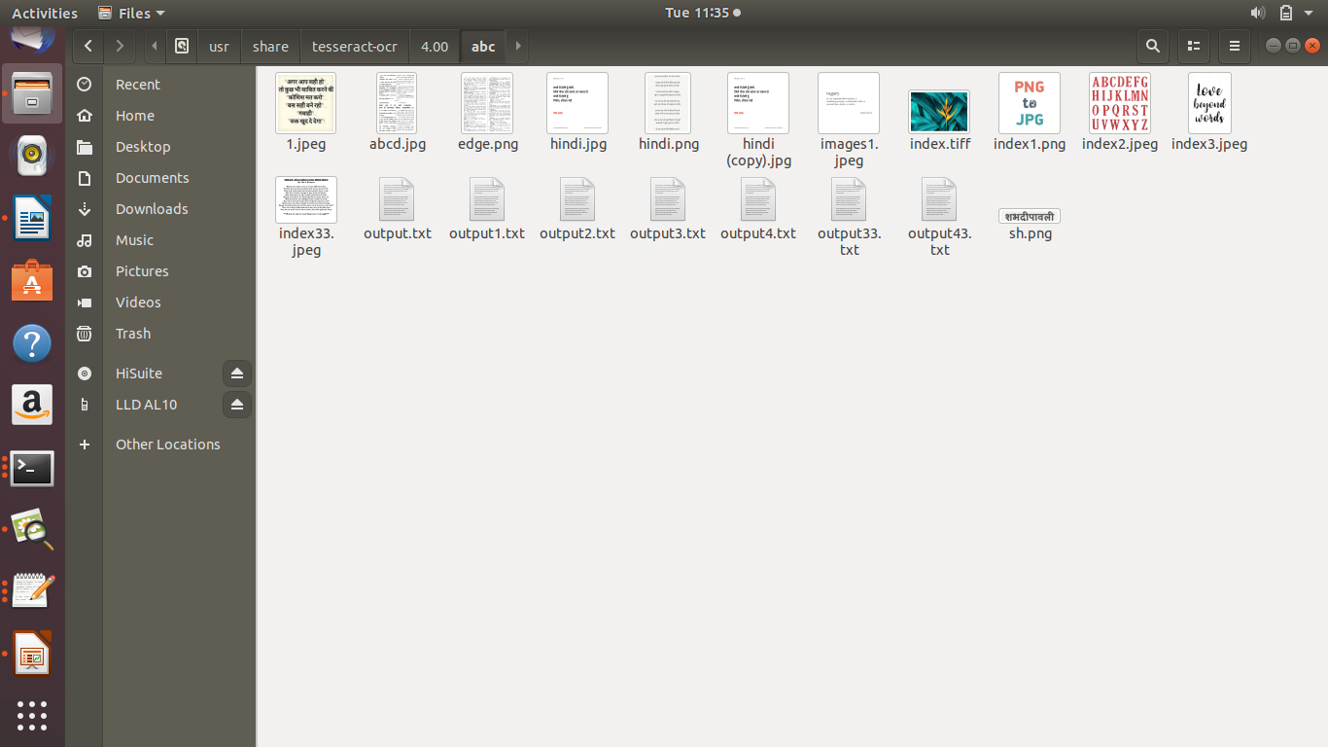

Slide 15
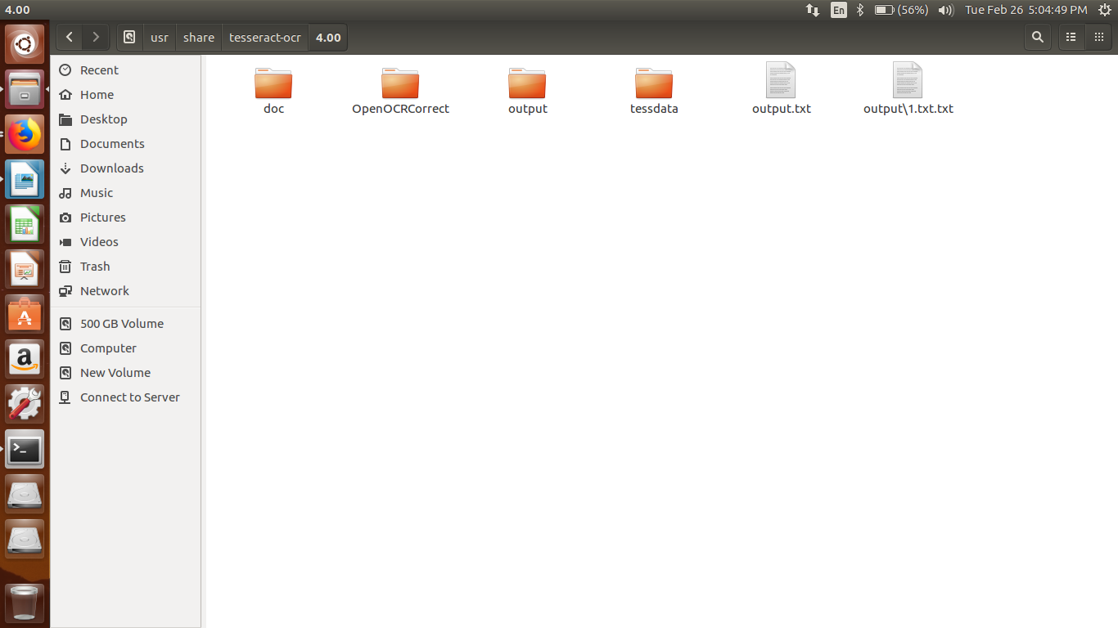

Slide 16
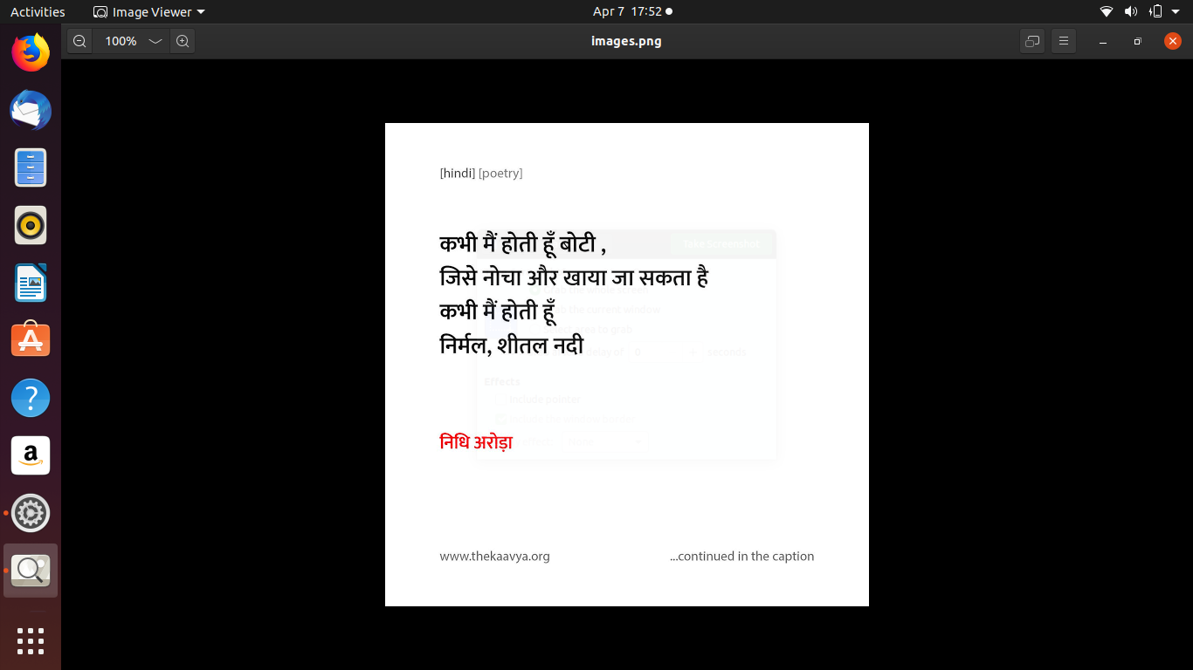

Slide 17
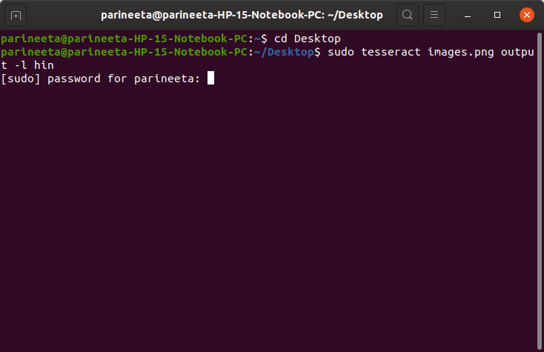

Slide 18
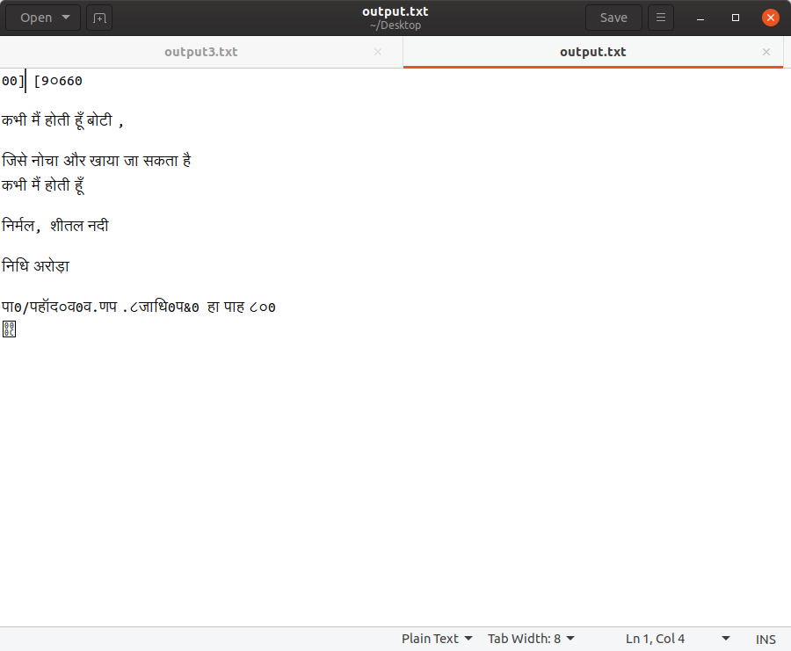

Slide 19
Image Processing using OCR of Google Docs.
Google Docs. OCR (Optical Character Recognition ) is a tool provided by Google which takes image as an input and generates output as a text format.
Google Drive is a file storage and synchronization service developed by Google.
The image is first uploaded to the Google Drive.
Then the image is opened by right clicking it and selecting open with Google Docs.
The two file will get generated, one would be consist of the input file containing the image which is to be processed
And other part would consist of the text ocr file.

Slide 20
Things to be noted:
Format: You can convert .JPEG, .PNG, .GIF, or PDF (multipage documents) files.
File size: The file should be 2 MB or less.
Resolution: Text should be at least 10 pixels high.
Orientation: Documents must be right-side up. If your image is facing the wrong way, rotate it before uploading it to Google Drive.
Languages: Google Drive will detect the language of the document.
Font and character set: For best results, use common fonts such as Arial or Times New Roman.
Image quality: Sharp images with even lighting and clear contrasts work best.
Convert an image file
On your computer, go to drive.google.com.
Right-click on the desired file.
Click Open with and then Google Docs.
The image file will be converted to a Google Doc, but some formatting might not transfer:
Bold, italics, font size, font type, and line breaks are most likely to be retained.
Lists, tables, columns, footnotes, and endnotes are likely not be detected.

Slide 21
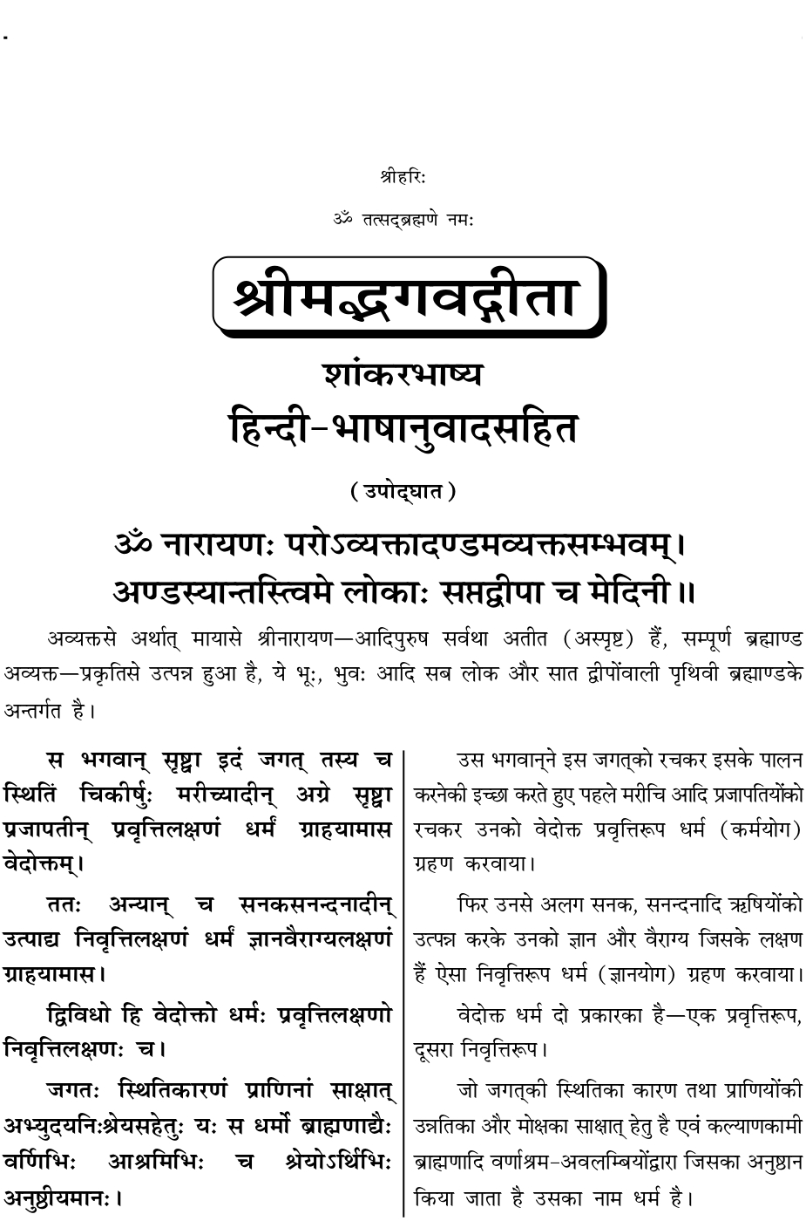
Input image to Google Docs

Slide 22
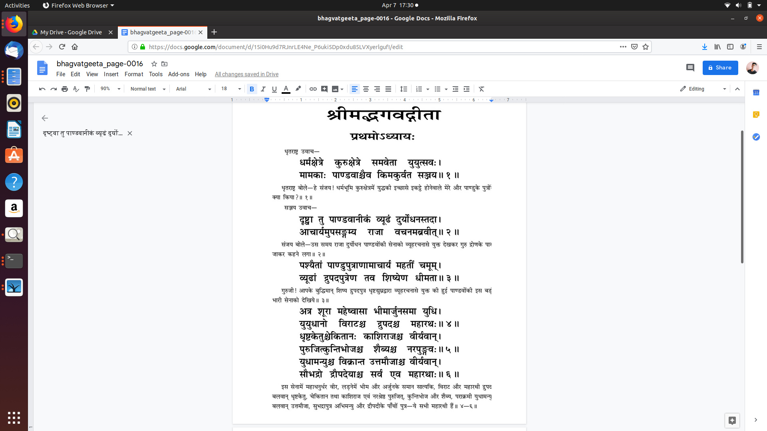
Input Screenshot

Slide 23
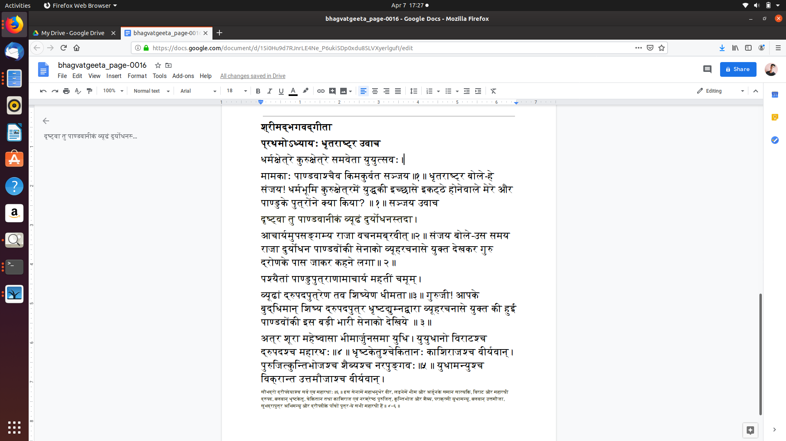
Output screenshot

Slide 24
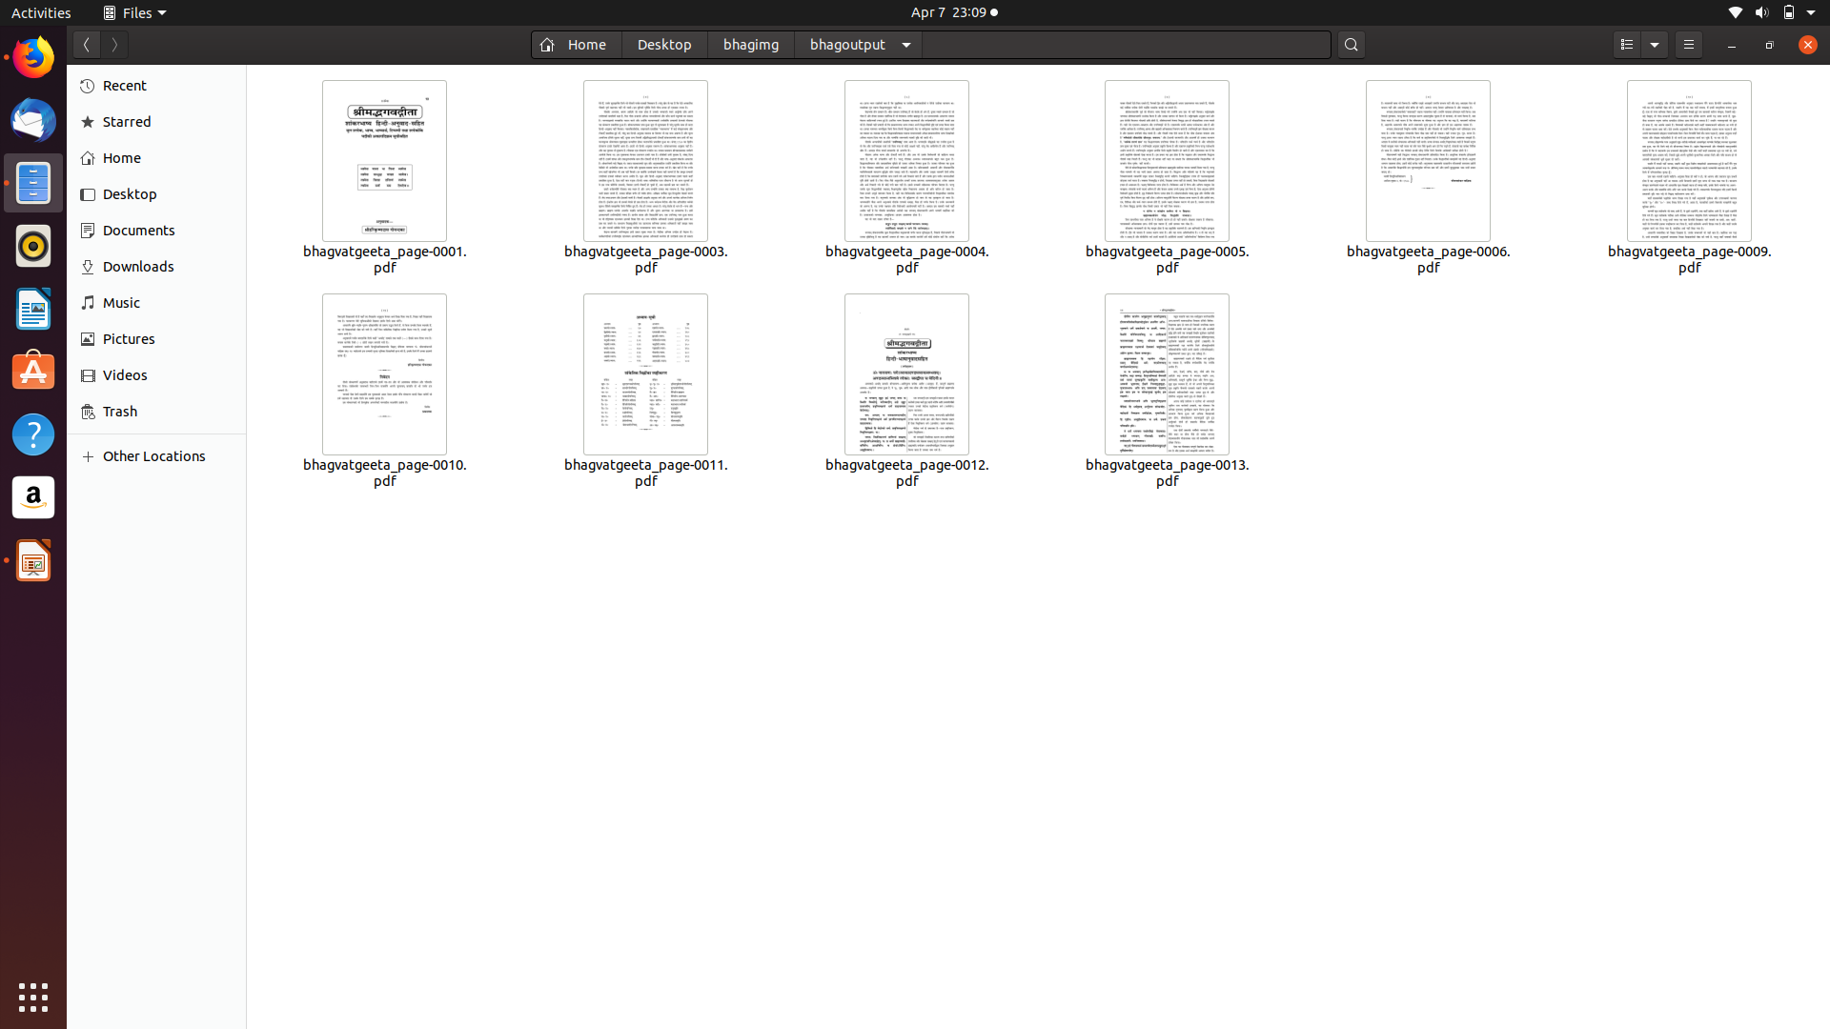
Following are all the images which are processed in the google docs.

Slide 25
Thank You…

